Slide 1
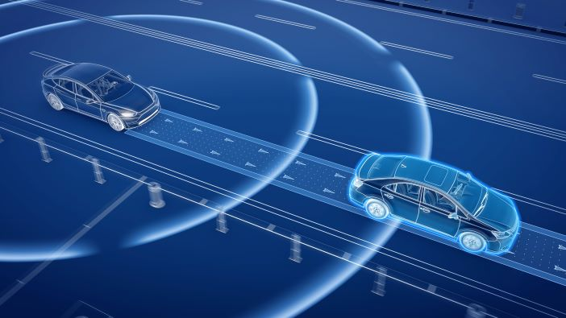
Feature Extraction
By Shashank Garikipati on 7/15/2022

Slide 2
This presentation is organized as follows
Motivations and Definitions
Motivations
Basic vehicle definitions
All about patches
Metrics
Basic Plotting Functions
Vehicle Collision Detection
Construction zones and obstacles
Straight path collision detection
Curved path collision detection
Dataset Point Association
K-nearest-Neighbor algorithm
Associated Data Statistics and Modifications

Slide 3
Motivations and Definitions

Slide 4

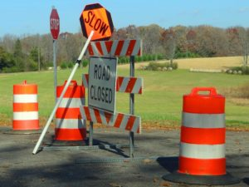
The dynamic and case-specific nature of construction work zones makes it especially difficult for autonomous vehicles to navigate through them
Some objects found in a work zone (not an exhaustive list)
[morrisseylawfirm.com]
[Freepik.com]

Slide 5
For this project, we are going to deal with the objects that are commonly found in construction zones
Add picture here with all objects from PennDot

Slide 6
Basic Vehicle Definitions

Slide 7
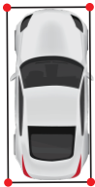
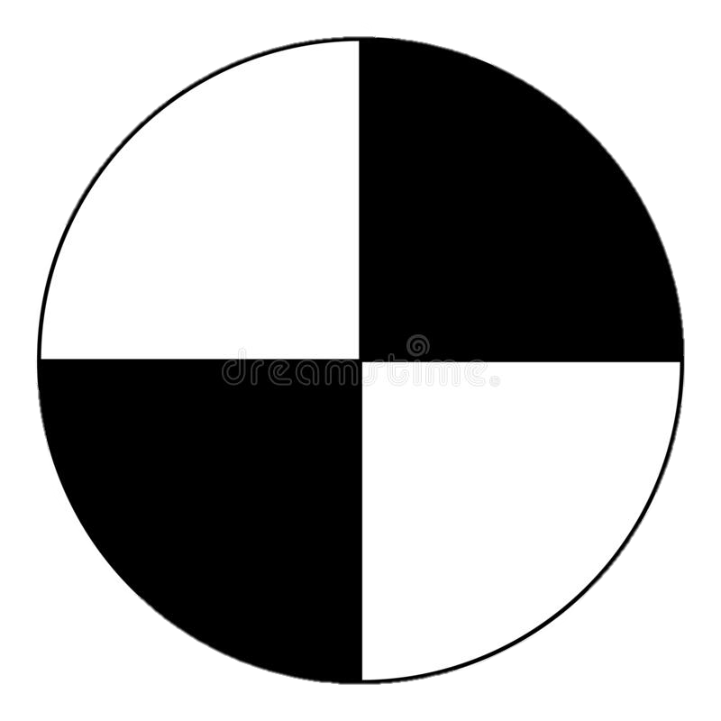
We define the following vehicle properties, in body-fixed coordinates
CG-front bumper distance (df)
CG-rear bumper distance (dr)
Track width (T)
= Center of Gravity (CG)

Slide 8
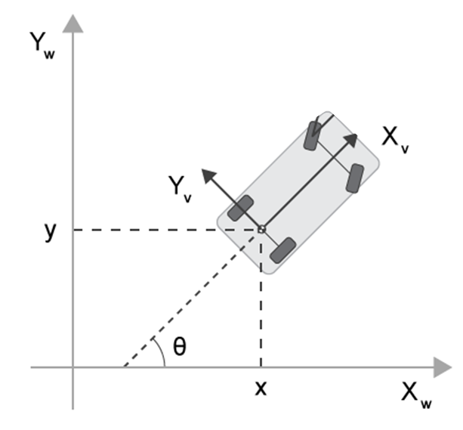
Sometimes axle-fixed coordinates are used, centered on the rear axle
This is because CG can be difficult to measure, can change, and because most vehicle kinematic motion (low speed) is easily modeled as movement around this point.
[mathworks.com]

Slide 9
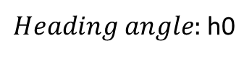
The heading angle is defined as the angle between the positive x axis and the heading (direction the vehicle is facing).
N
Heading
$Heading angle:$h0
W
E
S

Slide 10
Slip angle is the angle between the vehicle’s velocity vector and the heading
Vehicle velocity
Slip angle
Heading

Slide 11
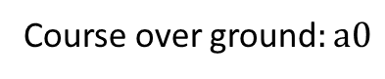
Course over ground is defined as the angle between the positive x axis and the vehicle’s velocity vector
N
Vehicle velocity
Course over ground$:a0$
W
E
S

Slide 12
All About Patches

Slide 13
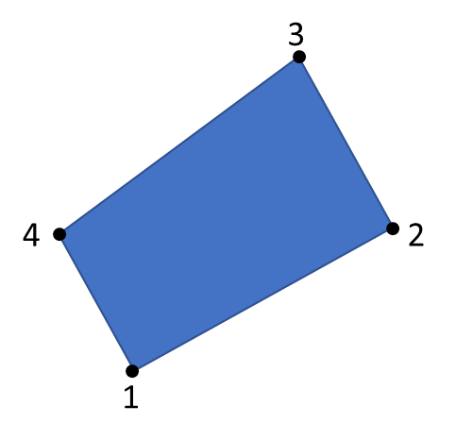
Patches are used to represent objects that the vehicle can potentially collide into
Patches are represented as [1 x N] struct array in MATLAB
They are primarily defined by the x and y coordinates of their verticies inputted as two [M x 1] vectors for x and y, and a [1 x 3] RBG color vector.

Slide 14
Patches have directionality – namely the ordering of the vertices defines the surface normal vector.
Anticlockwise ordering means the surface normal points out of the page

Slide 15
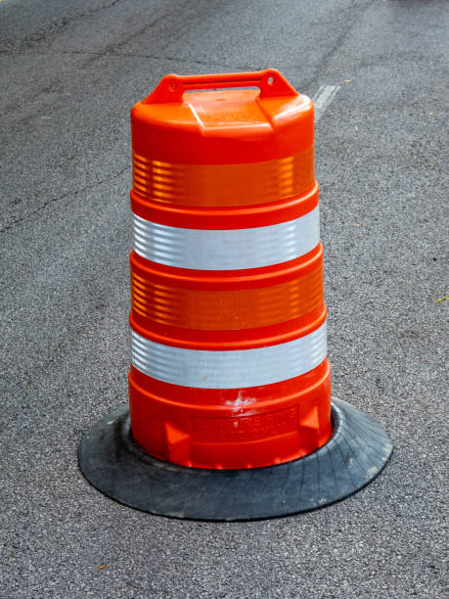
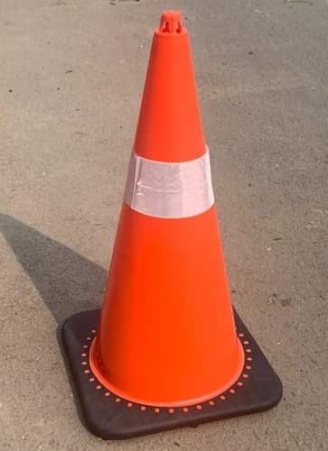
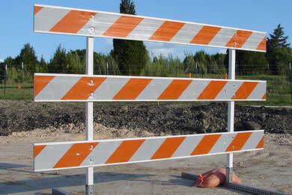
A collidable object is any object that can the vehicle can collide with
[istockphoto.com]
[pragati-trafficsafety.com]
[https://www.pexco.com]
*Not an exhaustive list

Slide 16
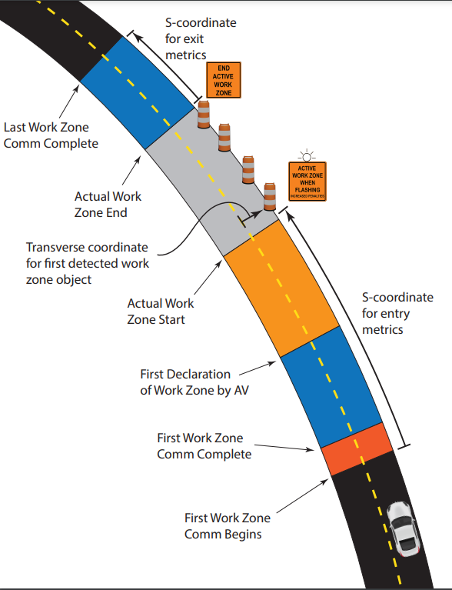
Construction work zones take various shapes, and tend to have various collidable objects on and near roads
It is important to be able to quickly and accurately detect objects that can potentially collide with the car

Slide 17
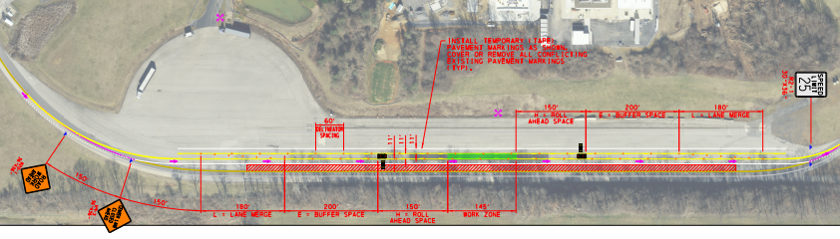
Here is one example of what a construction zone could look like

Slide 18
Metrics

Slide 19
To achieve safe navigation for AVs through a work zone, we define certain measures and metrics. These require geometric functions to calculate intersections, nearest points, etc.
Example of metrics include:
Time to Collision (TTC)
Minimum clearance distance over all objects
Smallest clearance to each object category
If impact, location of impact on the vehicle
If impact, location of impact on the object

Slide 20
Basic Plotting Functions

Slide 21
A function in the Feature Extraction library allows users to XY datasets
Adapted from fcn_Path_plotTraversalsXY function in the path library
The input to function is an {Mx[Nx2]} cell structure of XY points, where N is the number of points and M is the number of datasets
The function outputs a plot showing the datasets as shown to the left
Function: fcn_Points_plotSetsXY.m
Script: script_test_fcn_Points_plotSetsXY.m

Slide 22
Users can create their own XY data using a function in this library
Function was adapted from fcn_Path_fillPathViaUserInputs from the path library
This is a function for the user to click on the figure to generate XY path. Points are collected and plotted until the user double clicks.
The function outputs a plot showing the datasets as shown to the left
Function: fcn_Points_fillPointSetViaUserInputs.m
Script: script_test_fcn_Path_fillPathViaUserInputs.m

Slide 23
Patches can be easily visualized through the plotPatch function
Function: fcn_Patch_plotPatch.m
Script: script_test_fcn_Patch_plotPatch.m
The input to function is cell structure (Patch array) of X and Y points, where the points are inputted in an anticlockwise manner.

Slide 24
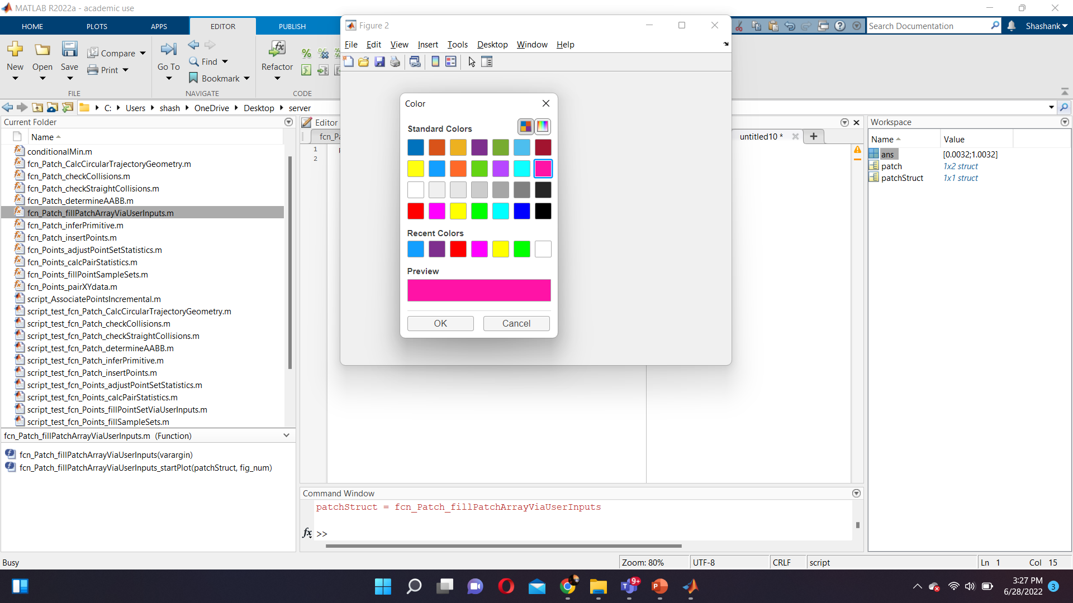
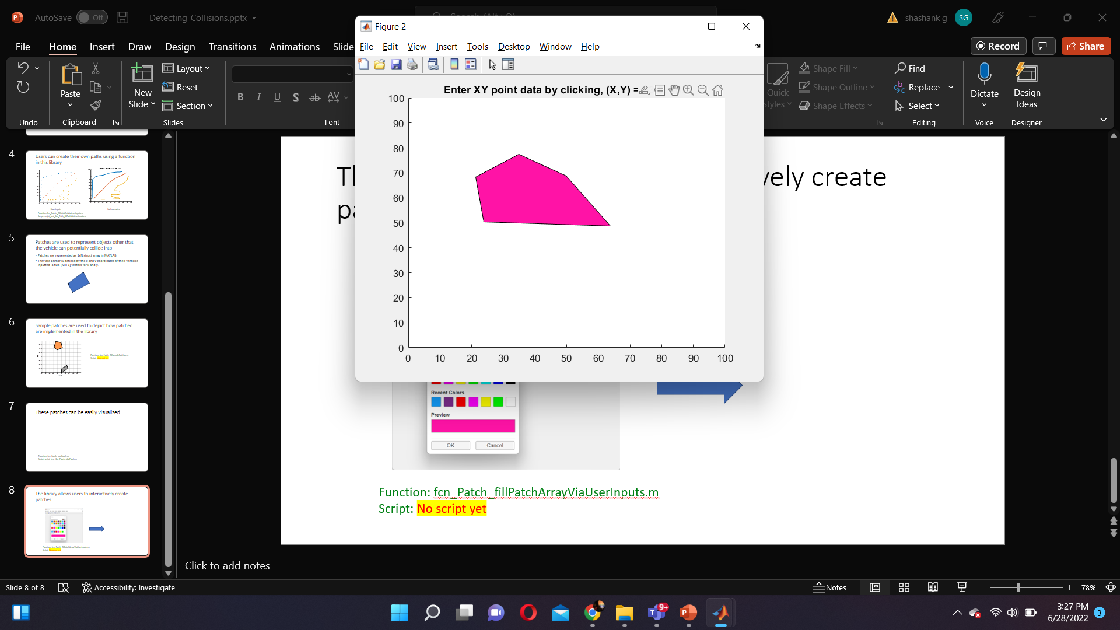
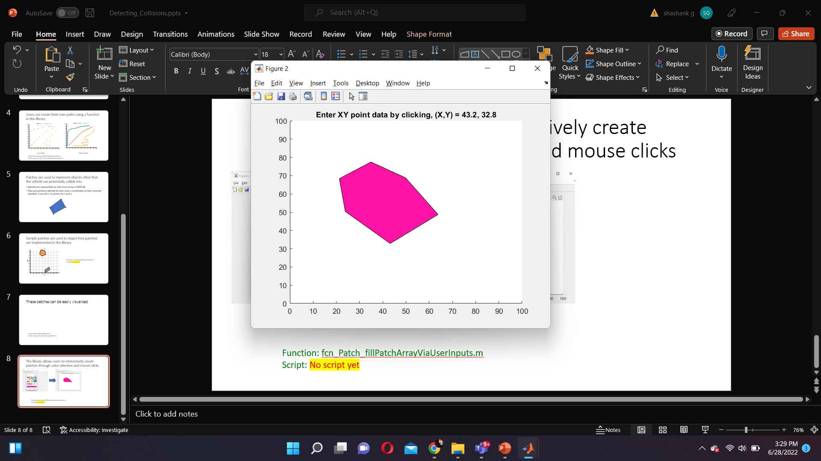
The library allows users to interactively create patches through color selection and mouse clicks
Function: fcn_Patch_fillPatchArrayViaUserInputs.m

Slide 25
Sample patches are used to illustrate how patched are implemented in the library
Function: fcn_Patch_fillSamplePatches.m
This function has no inputs. When run, the plot on the left is shown

Slide 26
During collision detection, Axis Aligned Bounding Boxes (AABB) allow us to quickly filter out “misses” by checking for overlap between bounding boxes
Inputs to this function is a patch array of a cell structure with X and Y points
Function: fcn_Patch_determineAABB.m
Script: script_test_fcn_Patch_determineAABB.m
This is faster because we don’t have to compare vertices for each patch

Slide 27
An overlap between AABBs doesn’t necessarily mean an intersection is guaranteed
Intersection between AABBs but not between patches
Intersection between patches and AABBs

Slide 28
Plotting Construction Zones and Obstacles

Slide 29
Specific plotting functions have been written for construction-specific obstacles (Explained in more detail in further slides)
Barrels
Cones
Type III barricades

Slide 30
Construction work zones take various shapes, and tend to have various collidable objects on and near roads
The vehicle is shown as the blue box outline and objects are shown as colored in patches

Slide 31
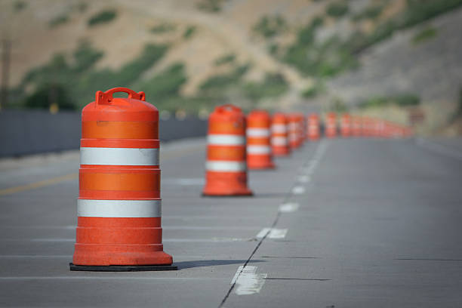
Common collidable objects found in construction sites are barrels, which from a top-down view can be modelled as regular octagon patches with radii of 0.2 meters.
[istockphoto.com]
Function: fcn_Patch_fillBarrelAtPoint.m
Script: script_test_fcn_Patch_fillBarrelAtPoint.m

Slide 32
The user can place barrels at any location and orientation using the fillBarrelAtPoint function
Π/8
Inputs to the function include [Nx2] coordinates of XY coordinates and [Nx1] vector of orientation points (in radians)

Slide 33
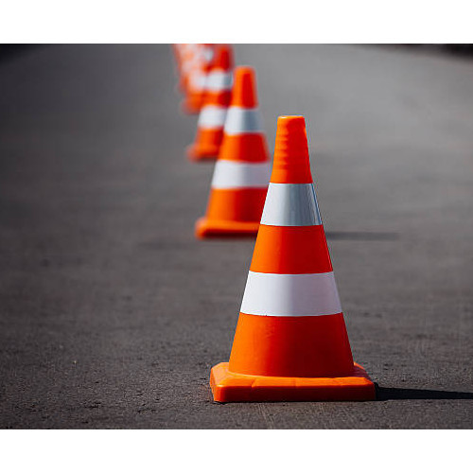
Similarly, Cones can be represented as octagons with radii of 0.16 meters
[indiamart.com]

Slide 34
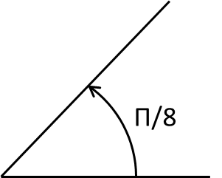
Like Barrels, the user can place cones at any location and orientation using the fillConeAtPoint function
Inputs to the function include [Nx2] coordinates of XY coordinates and [Nx1] vector of orientation points (in radians)

Slide 35
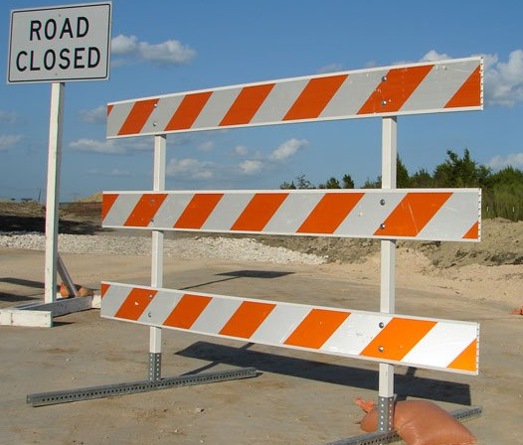
Type III barricades are represented as thin rectangles with a height of 1.5 meters and width of 1.2 meters.
[pexco.com]

Slide 36
The user can place type III barricades at any location and orientation using the fillType3BarricadeAtPoint function
Π/8
Inputs to the function include [Nx2] coordinates of XY coordinates and [Nx1] vector of orientation points (in radians)

Slide 37
We have a routine to plot a vehicle as a simple rectangle or with an outline of a vehicle. The details are optional, but useful to disambiguate the travel direction.
Something important to note is that we have to assume the vehicle is a rectangle for the algorithm to work. A collision could be predicted at a location where the vehicle may not exist (e.g. the "carved out corner")

Slide 38
We also have routines that plot trajectories, given the XY path a vehicle follows. This uses the Path library to calculate offset paths from the vehicle path.
Need to modify function to better visualize left and right lane boundaries

Slide 39
A more advanced path plotting algorithm uses the arc definitions at each segment, which more precisely captures the vehicle’s envelope

Slide 40
A function exists also to plot vehicles along a traversal, dropping images of the vehicle onto the traversal periodically to illustrate the motion

Slide 41
We have plot utilities to plot lane markers. Again, this uses the Path library to calculate offsets from the lane centerline.
*Need to modify function to better look like lane markers

Slide 42
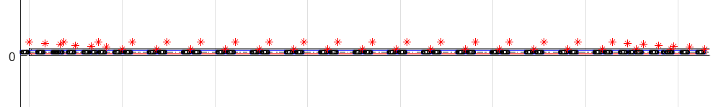
Several example construction zone configurations have been built, and function call can load and plot these configurations.
Matlab representation of construction Zone.
Plotted using script_test_fcn_Patch_construction_site.m

Slide 43
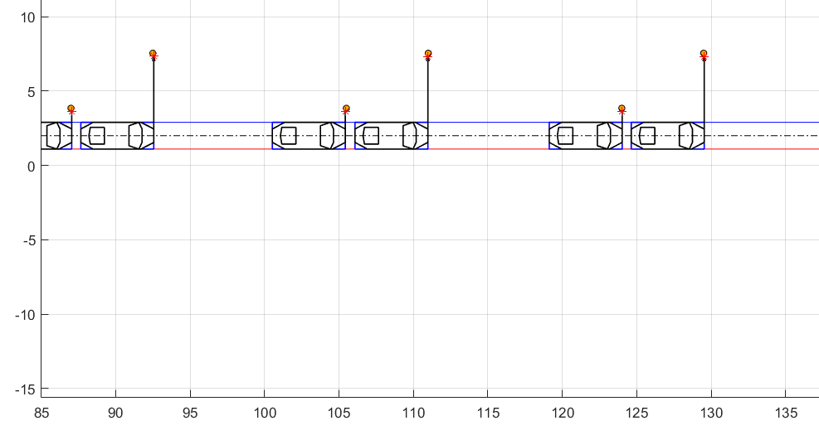
Here is a zoomed in version of the vehicle and near miss points to the channeling device

Slide 44
Straight Path Collision Detection

Slide 45
Finding the collision points between obstacles and a vehicle travelling down a straight path
Function: fcn_Patch_checkStraightCollisions.m
Script: script_test_fcn_Patch_checkStraightCollisions.m
Again, something important to note is that we have to assume the vehicle is a rectangle for the algorithm to work. A collision could be predicted at a location where the vehicle may not exist (e.g. the "carved out corner")

Slide 46
Assumptions before we proceed to solving the problem of straight trajectory collisions
Function: fcn_Patch_checkStraightCollisions.m
Script: script_test_fcn_Patch_checkStraightCollisions.m
For the sake of demonstration, We assume the collidable object to be in the shape of an arbitrary triangle (this algorithm works for any patch shape)
We assume the car to be approximated as a rectangle bounded by the maximum length and width of the car

Slide 47
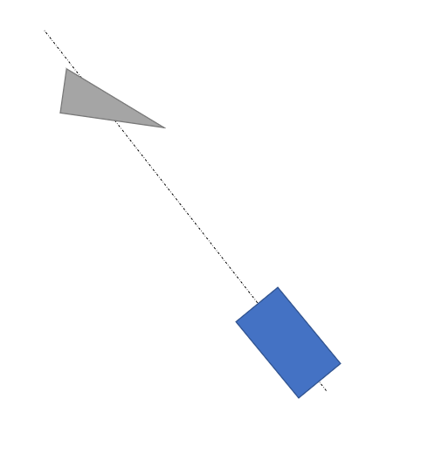
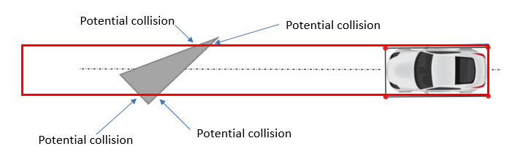
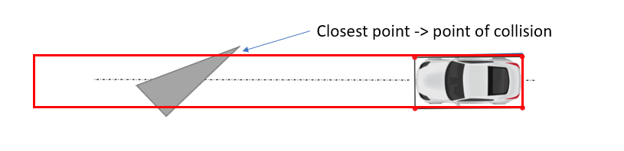
The strategy (explained in further details in upcoming slides)
Function: fcn_Patch_checkStraightCollisions.m
Script: script_test_fcn_Patch_checkStraightCollisions.m
Rotate (about CG) the vehicle and obstacles to point to the x-axis (to turn any situation into a standard problem) – use a rotation matrix
Use polyxpoly (matlab function to find intersection between two polylines) to find points of collision
We then check to see if there are any vertices of the object that lie on this rotated path
We then check to see if there have been any collisions by comparing the vertices and polyxpoly intersection points
collVertexInds = find(abs(rotObst(:,2)) < 1*vehicle.w/2 & rotObst(:,1) > -vehicle.dr);

Slide 48
Rotate (about CG) the vehicle and obstacles to point to the x-axis (to turn any situation into a standard problem) – use a rotation matrix

Slide 49
Use polyxpoly (matlab function to find intersection between two polylines) to find points of collision
We determine any obstacles that lie within or across the vehicle path on the positive the x-axis between the back of the vehicle (-vehicle.dr) and some large distance (1e6) (this area is given by the red box)
Potential collision
Potential collision
Potential collision
Potential collision
Link to polyxpoly documentation: https://www.mathworks.com/help/map/ref/polyxpoly.html

Slide 50
We then check to see if there are any vertices of the object that lie on this rotated path
collVertexInds = find(abs(rotObst(:,2)) < 1*vehicle.w/2 & rotObst(:,1) > -vehicle.dr);
Checking between x-axis between back of vehicle and come large distance
Checking within the width of the vehicle

Slide 51
We then check to see if there have been any collisions by comparing the points we obtained before
Closest point -> point of collision
If there is a collision, we compare whether the vertex was closer or polyxpoly point is closer. Which ever point is closer is the collision point.
If there is no collision, we try to find the minimum clearance and location of this on the obstacle.

Slide 52
Once this point is obtained, we rotate and translate it back to the original coordinate space
*
*
Collision point

Slide 53
If there is no collision at all, we determine the clearance of all the vertices on the obstacle to determine the location of the “near miss”
Near miss
The closest point ( minimum clearance is the point of near miss)

Slide 54
There are several test cases that the algorithm can encounter, which can be found in script_test_fcn_Patch_checkStraightCollisions.m
Collision with right edge
Collision with left edge

Slide 55
Collision with vertex
Collision with multiple objects’ vertex

Slide 56
The algorithm displays the location of the minimum clearances on the figure as near misses
Near miss
Multiple near misses

Slide 57
We can also have these different test cases plotted as a single scenario

Slide 58
Curved Path Collision Detection

Slide 59
Finding the collision between a objects and a vehicle travelling down a curved patch
Something important to note is that a straight path is considered to be a curved path with an infinite radius, so any path can be treated as a curved path.
However, we consider the straight path to be a special case and use fcn_Patch_checkStraightCollisions.m for that case
Function: fcn_Patch_checkCollisions.m
Script: script_test_fcn_Patch_checkCollisions.m

Slide 60
The strategy to determine circular trajectory collisions (explained in further details in upcoming slides)
Function: fcn_Patch_checkCollisions.m
Script: script_test_fcn_Patch_checkCollisions.m
Define pertinent radii and calculate center of path radius circle
Convert from vehicle body coordinates to inertial coordinates using a rotation matrix
Checking to find intersection points between vehicle vertex and object edge
Checking to find intersection points object vertex and vehicle edge
Checking for collision by comparing obtained intersection points or calculating near misses

Slide 61
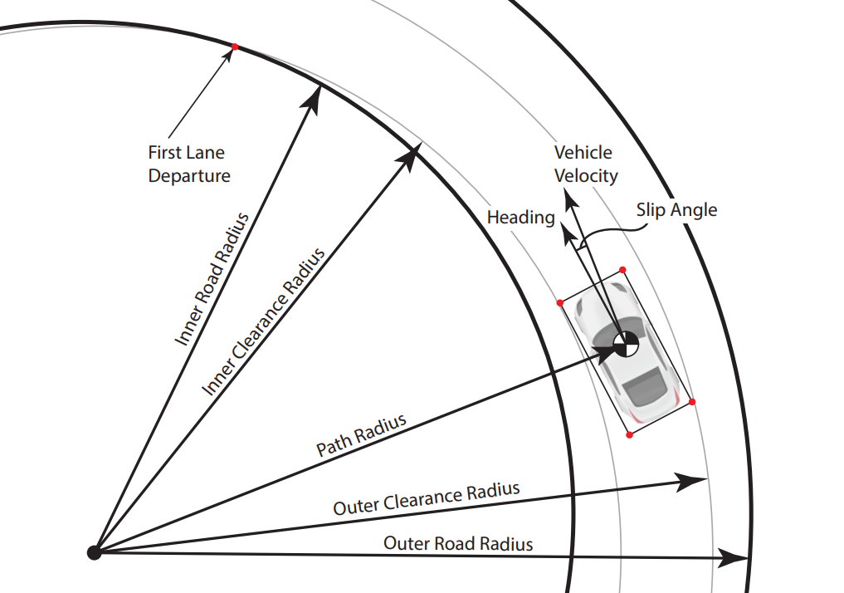
Vehicle trajectory for a curved path is defined by several pertinent radii

Slide 62
They are calculated as follows:
CG (circle) and CG path (black dash-dot line)
Front left and front right corner paths (gray lines)
Maximum clearance radius (blue line)
Minimum clearance radius (red line)
a

Slide 63
We first use a function in the library to find these pertinent radii of the circular trajectory that the vehicle can clear without collision
It also returns the tangent point (given by the *)
of the inner limiting radii
Function: fcn_Patch_CalcCircularTrajectoryGeometry.m
Script: script_test_fcn_Patch_CalcCircularTrajectoryGeometry.m

Slide 64
Object vertices radii are calculated with respect to the center of trajectory of the vehicle
v3
v4
Center of vehicle
trajectory
v5
v2
v1
v1 radius

Slide 65
Then, we calculate the angle for each bounding point on the car with respect to the center of the circular trajectory at the start point
Circular trajectory
LF – Left front
RF – Right front
LR – Left rear
RR – Right rear
CoG – Center of gravity
Bounding points
of the car
Center of trajectory
x1
LF
RF
For instance, to calculate the angle for LF:
Theta = tan⁻¹(y1/x1)
y1
theta
LR
RR
COG

Slide 66
We repeat a similar calculation to obtain angles for the vertices of all the obstacles
v3
v4
Center of vehicle
trajectory
v5
v2
v1
theta

Slide 67
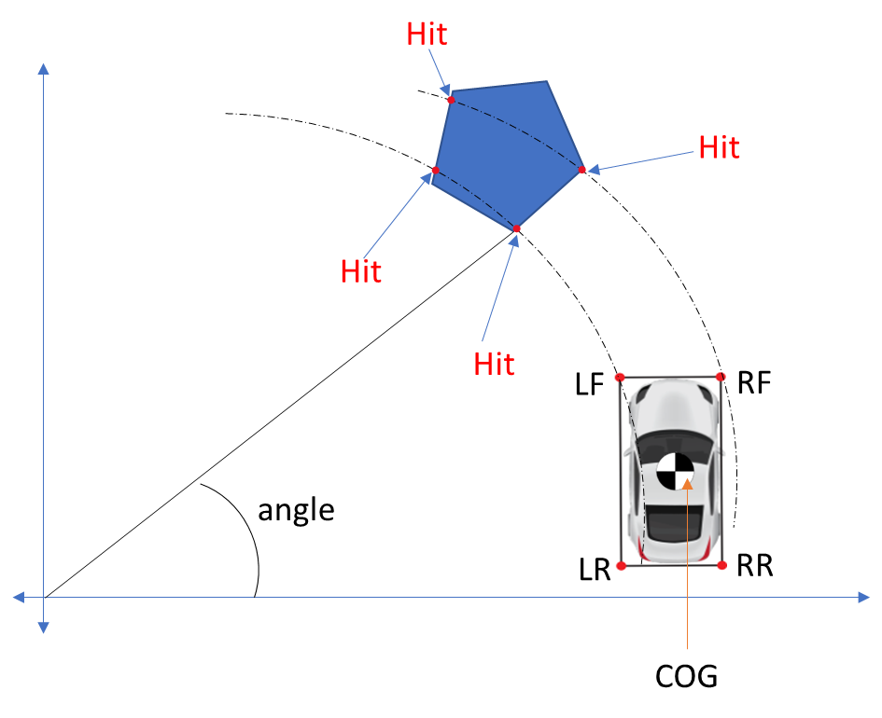
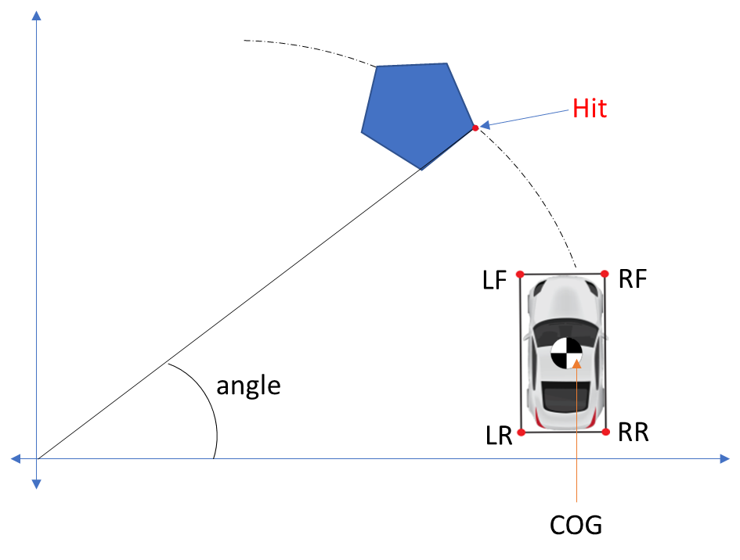
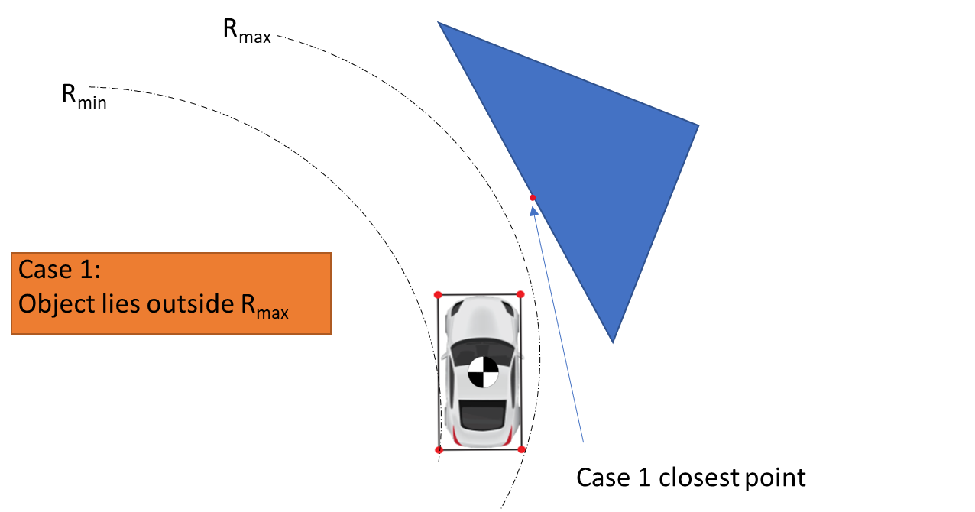
The section of code that checks hits and misses is split into three sub-sections.
Section 1: vehicle vertex to object edge checks
Section 2: object vertex to vehicle edge checks
Section 3: first collision selection, or clearance calculation

Slide 68
We compare the left and right front vehicle vertices to each of the object edges to check for collision using a function in the geometry library
Section 1
Edge 3
Front vertices of vehicle
Edge 2
Edge 1
LF
RF
LR
RR
COG

Slide 69
The function works by comparing the circles formed by each of the vehicle’s vertices to the lines formed by each edge of the obstacle
Section 1
Hit
Function from geometry library used: fcn_geometry_findIntersectionLineSegmentWithCircle
The function returns the angle and point of intersection with respect to the x-axis with the center of the circle trajectory being the origin
Check geometry library for more information about the function
Hit
Center of trajectory
Hit
Hit
LF
RF
angle
LR
RR
COG

Slide 70
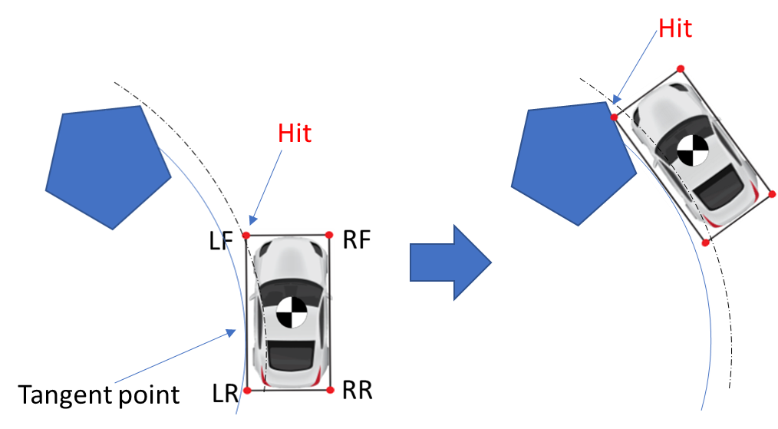
A special kind of collision could occur when the edge spans the max radius with vertex outside of outer front track radius
This case is tackled in a similar method to above
The circle formed by the radius of the tangent point (indicated by the red dot) is compared to vertices of the object using fcn_geometry_findIntersectionLineSegmentWithCircle in the geometry library

Slide 71
In section 2, we start off by determining whether a vertex falls into the vehicle’s trajectory
This is achieved by first comparing the vertex’s radii to the vehicle’s minimum and maximum radii
Secondly, we check to see that if lies in between the trajectory of the front edge specifically
if vertexRadii(vertexInd) > Rmin && vertexRadii(vertexInd) < Rmax
% First, check the front of the vehicle, which will have a
% collision if the obstacle vertex lies between the radii of
% the LF and RF points. But need to check both cases since
% the ordering of the radii magnitude will change depending on
% the direction of travel.
if (vertexRadii(vertexInd) >= R_LF && vertexRadii(vertexInd) <= R_RF) || (vertexRadii(vertexInd) <= R_LF && … ...vertexRadii(vertexInd) >= R_RF)
% If the vertex has an intersection with the front of the
% vehicle, calculate the intersections

Slide 72
If a vertex does exist on the trajectory , We compare the object vertices to each of the vehicle’s front edge to check for collision
Section 2
Repeat for each objects’ vertex that lie in the trajectory of the vehicle to find and store angle and point of intersection
Hit
Center of trajectory
LF
RF
angle
LR
RR
COG

Slide 73
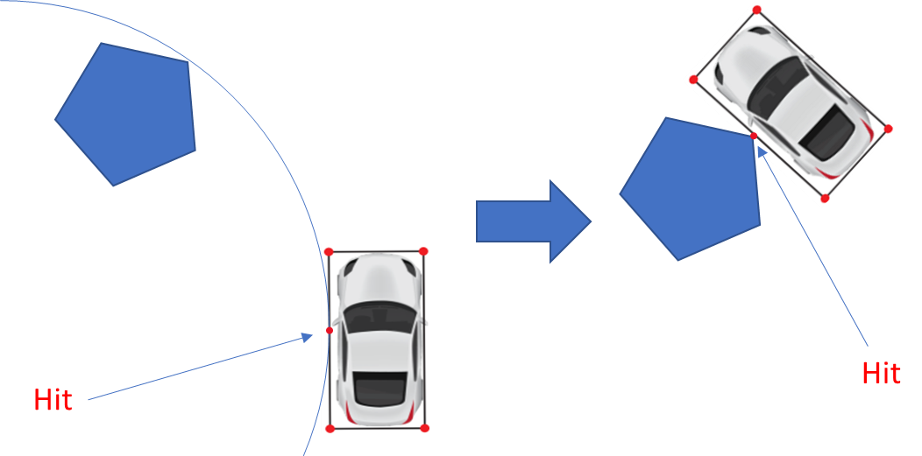
A special “sideswipe” could occur, where the object’s vertex collides with one of the two vehicle side edges
Section 2
This case is tackled in a similar method to above
The circle formed by the radius of the tangent point (indicated by the red dot) is compared to vertices of the object using fcn_geometry_findIntersectionLineSegmentWithCircle in the geometry library

Slide 74
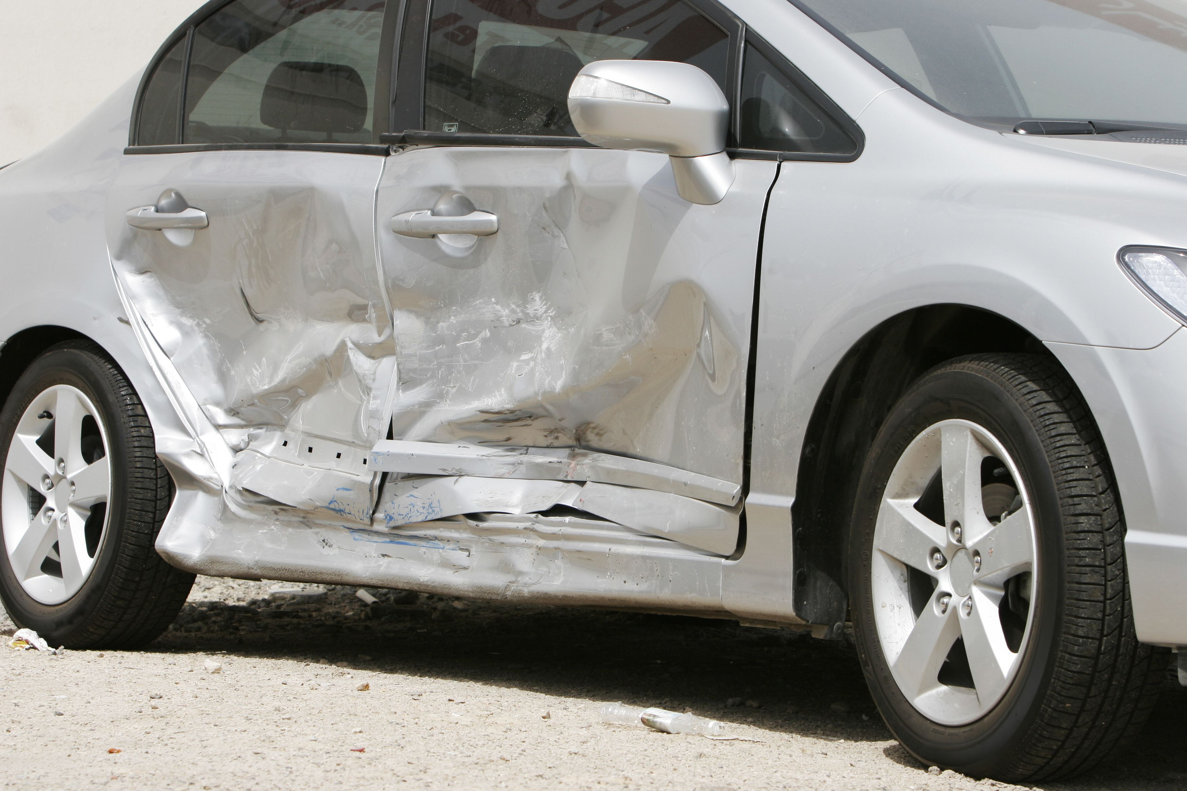
Sideswipe collisions occur regularly in real life resulting in damages to the side of the vehicle
Section 2
[www.randyakin.com]

Slide 75
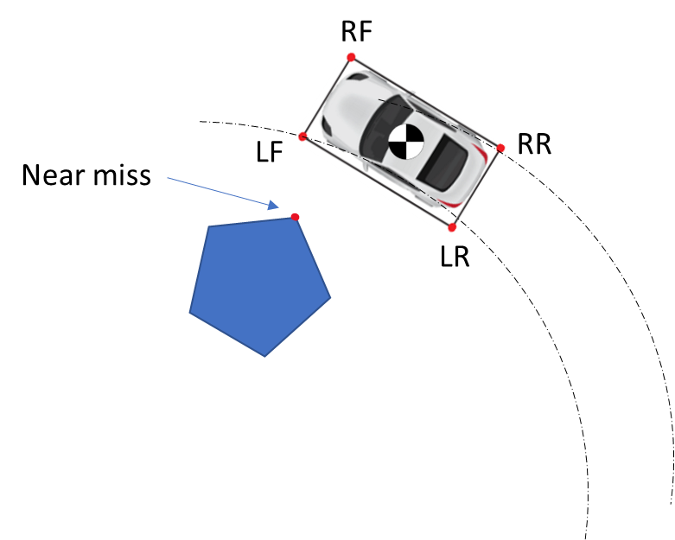
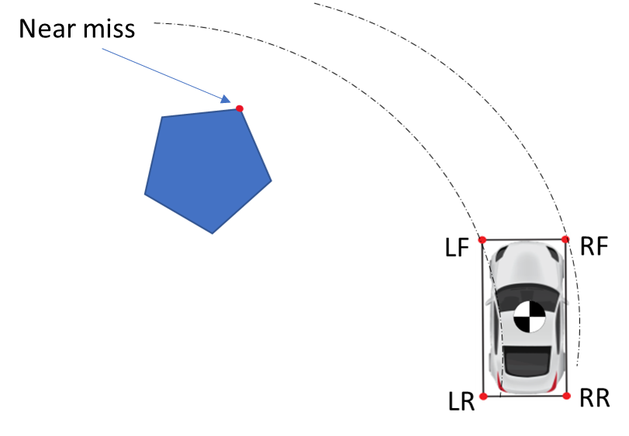
Once the first two checks are complete, we consider the case where no intersections were detected for an object
Section 3

Slide 76
The closest point on the object to the vehicle’s trajectory is the point of near miss
Section 3
Closest point =>

Slide 77
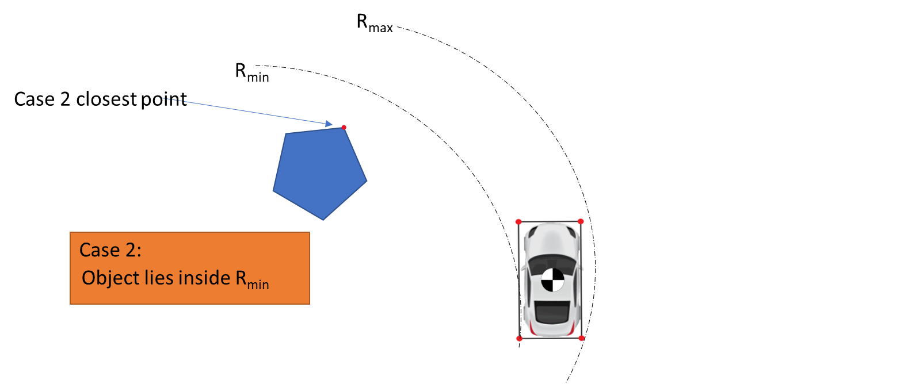
There are two possible scenario’s we need to consider to determine this point
Section 3

Slide 78
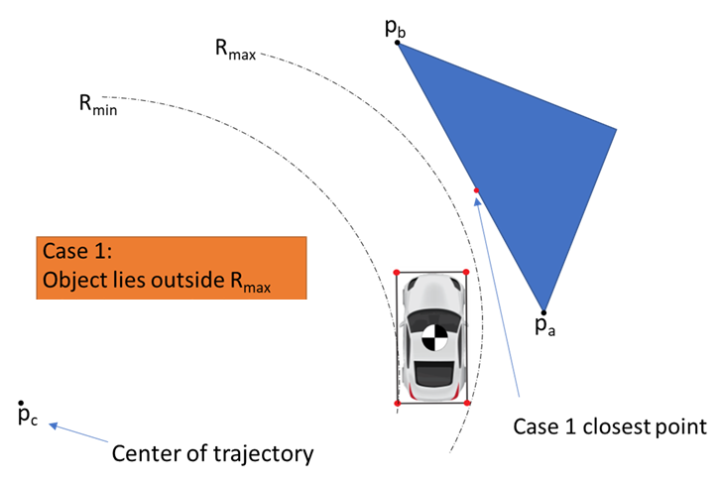
For case 1, The “near miss” point on the obstacle can lie anywhere on the edge depending on the situation, so we use alpha to find this point
Section 3
Alpha is a ratio defined as:
Alpha = (p_{a}(x) – p_{c}(x))*(p_{b}(x) – p_{a}(x)) + (p_{a}(x) – p_{c}(x))*(p_{b}(x) – p_{a}(x))
((p_{b}(x)-p_{a}(x))² + (p_{b}(y)-p_{a}(y))²
If 0 < alpha < 1, the intersection lies on the edge and can be computed as : Intersection point = p_{a} + alpha*(p_{b} – p_{a})
If alpha does not lie within this range, Intersection point = p_{a} because it is closer of the two points

Slide 79
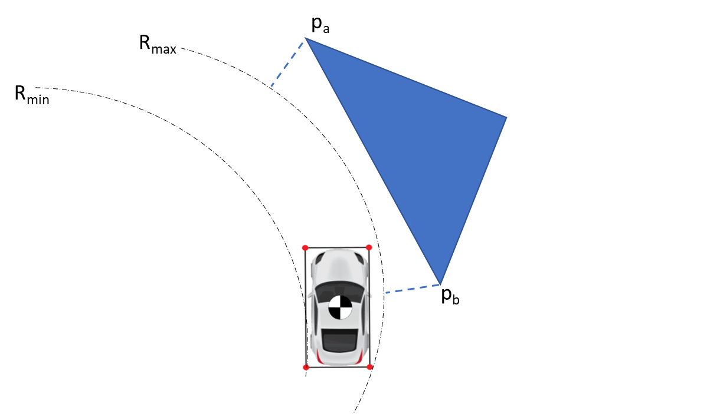
We determine point p_{a} and p_{b}( the two closest outer vertex points) by finding the minimum distance from these points to the max radius
Section 3
The distances can be easily computer as:
d = Radius(p_{a}) – R_{max}
The points with the shortest two distances will be p_{a} and p_{b}

Slide 80
For case 2, The “near miss” point is simply the closest vertex to the minimum that can be easily computed by comparing distances like case 1
Section 3
The distances can be easily computer as follows:
d = R_{min} - Radius(p_{a})
The points with the shortest distances will be p_{a}
p_{a}

Slide 81
There are numerous possible collision/near miss possibilities, which are summarized in the table below
 | Front of Car | Inside of Car | Outside of Car
Vertex within track width | Direct calculation of vertex angle relative to center | N/A | N/A
Vertex between inside front corner and min radius | N/A | Calculate distance ahead of CG for collision then offset from vertex angle | N/A
Vertex between outside front corner and max radius | N/A | N/A | Calculate distance behind CG for collision then offset from vertex angle
Edge entirely within track width | Handled by vertex checks | N/A | N/A
Edge between min radius and track width | Handled by vertex check if track width vertex comes first | Circle/edge intersection check with inside front | N/A
Edge between max radius and track width | Handled by vertex check if track width vertex comes first | N/A | Circle/edge intersection check with outside front
Edge spans the track width but vertices within min and max radii | N/A unless edge is perfectly parallel to front of car | Circle/edge intersection check with inside front | Circle/edge intersection check with outside front
Edge spans min and max radii | N/A unless edge is perfectly parallel to front of car | Circle/edge intersection check with inside front | Circle/edge intersection check with outside front
Edge spans max radius with vertex outside of outer front track radius | N/A | N/A | Circle/edge intersection check with outside rear OR vertex check behind CG (depends on edge angle)
Edge spans min radius with vertex outside of inner front track radius | N/A | Vertex check ahead of CG | N/A
Vertices outside max/min radii (near miss) | N/A | Determine point with minimum difference from CG radius by vertices | Determine point with minimum difference from CG radius by vertices and nearest point on edges.
Cases are shown with images in upcoming slides

Slide 82
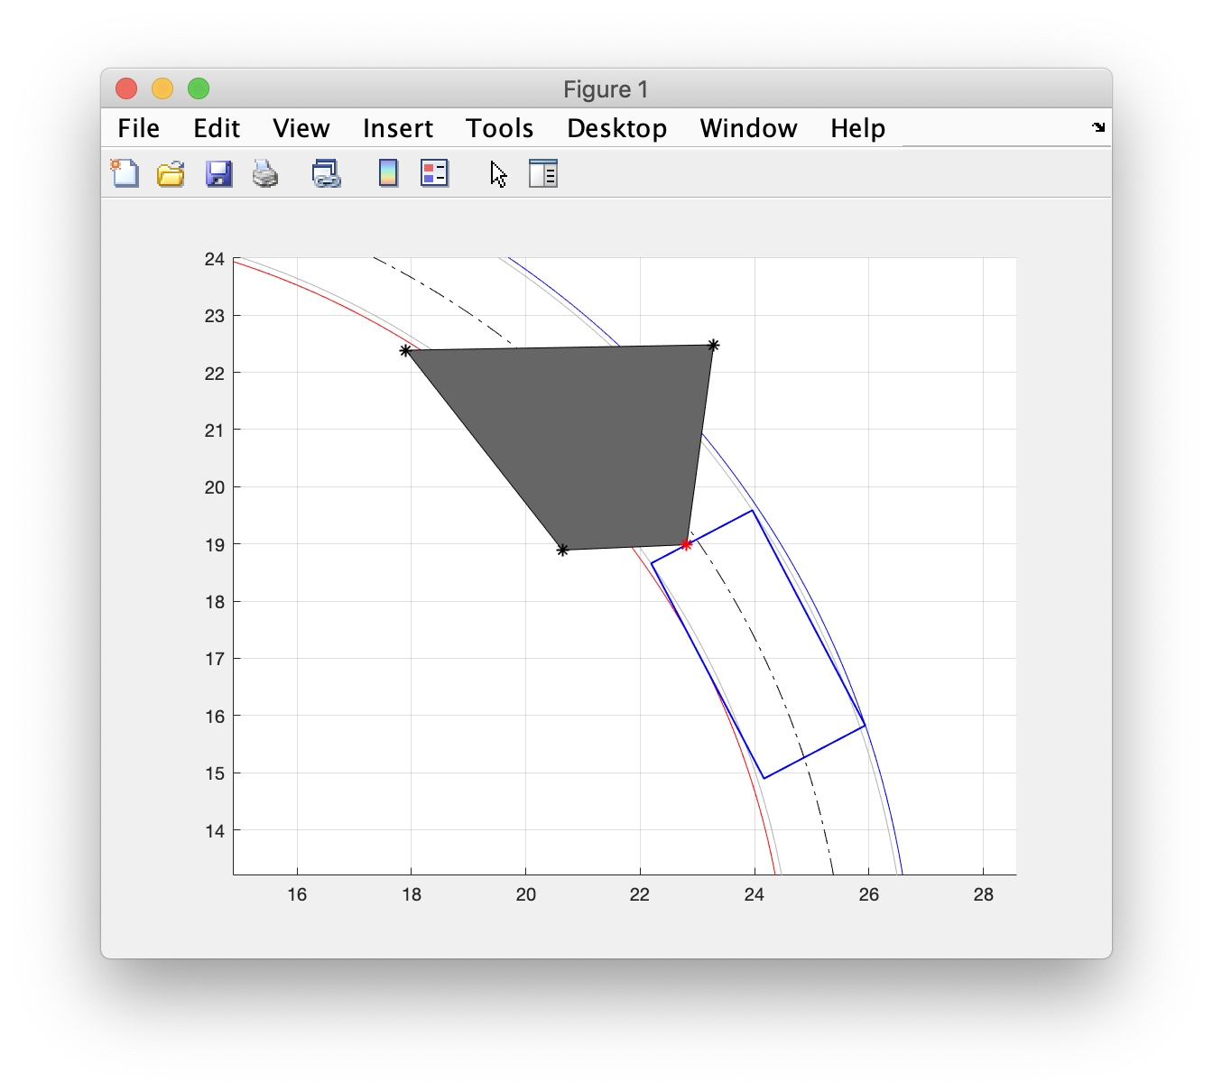
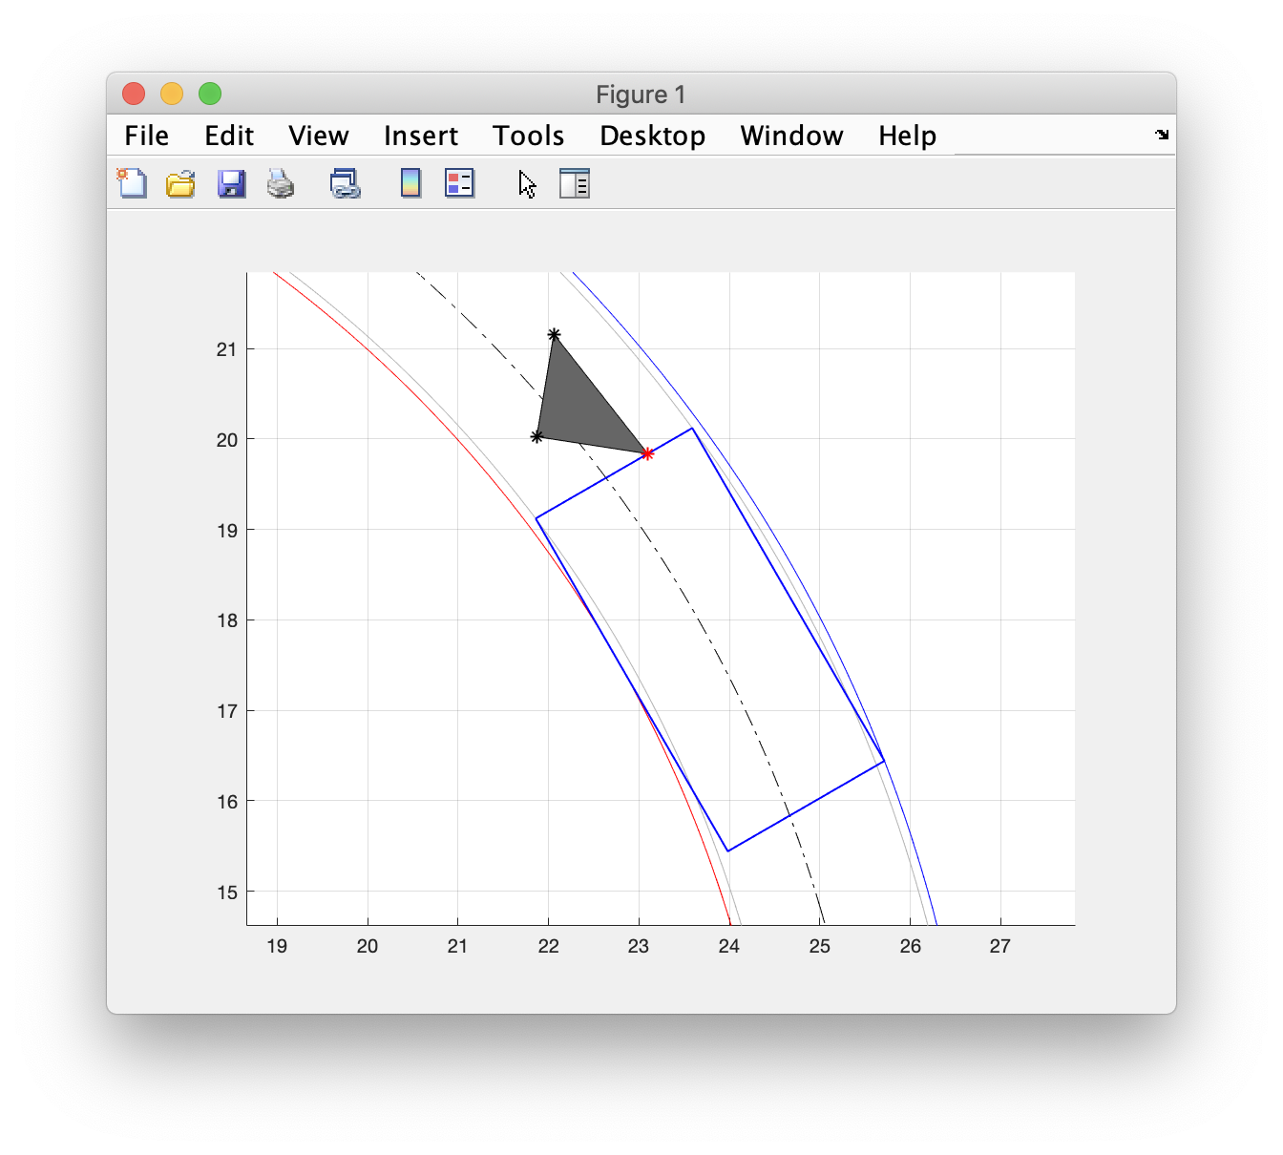
Vertex/vertices is within track width

Slide 83
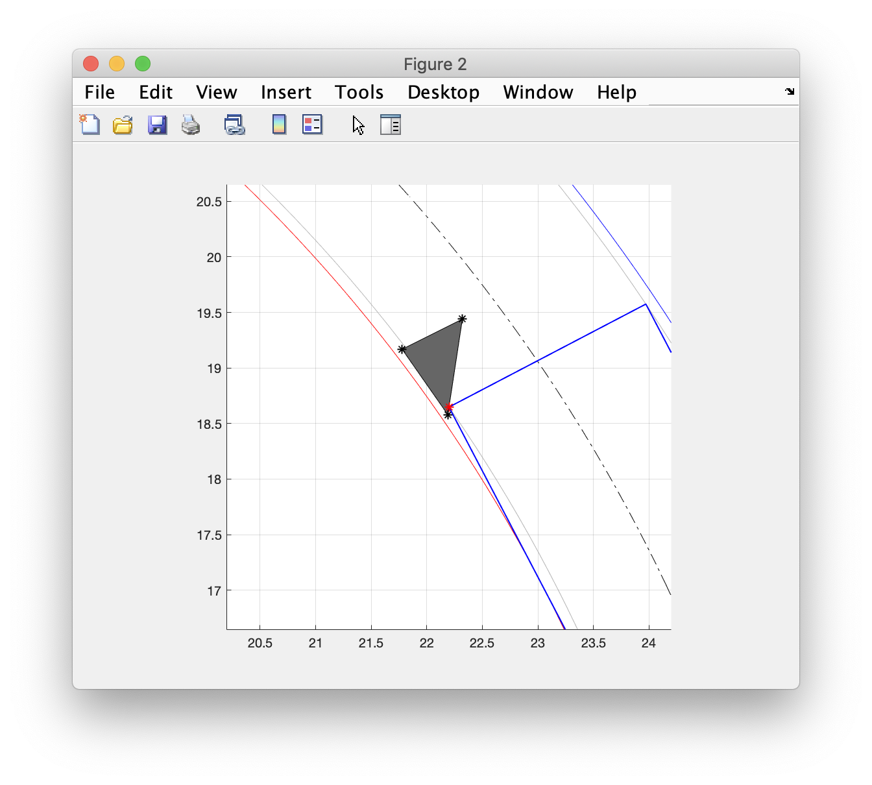
Vertex is between inside front corner and minimum radius

Slide 84
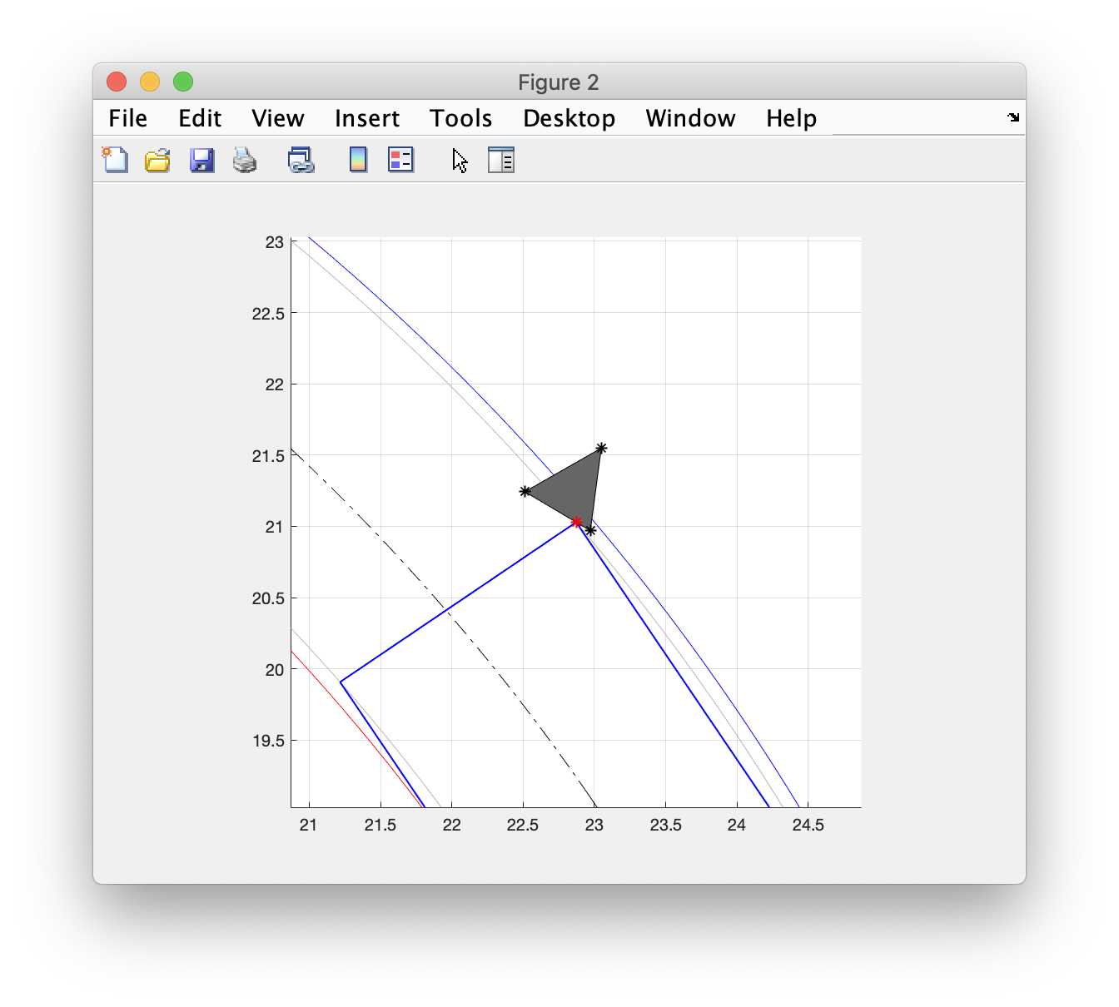
Vertex is between outside front corner and maximum radius

Slide 85
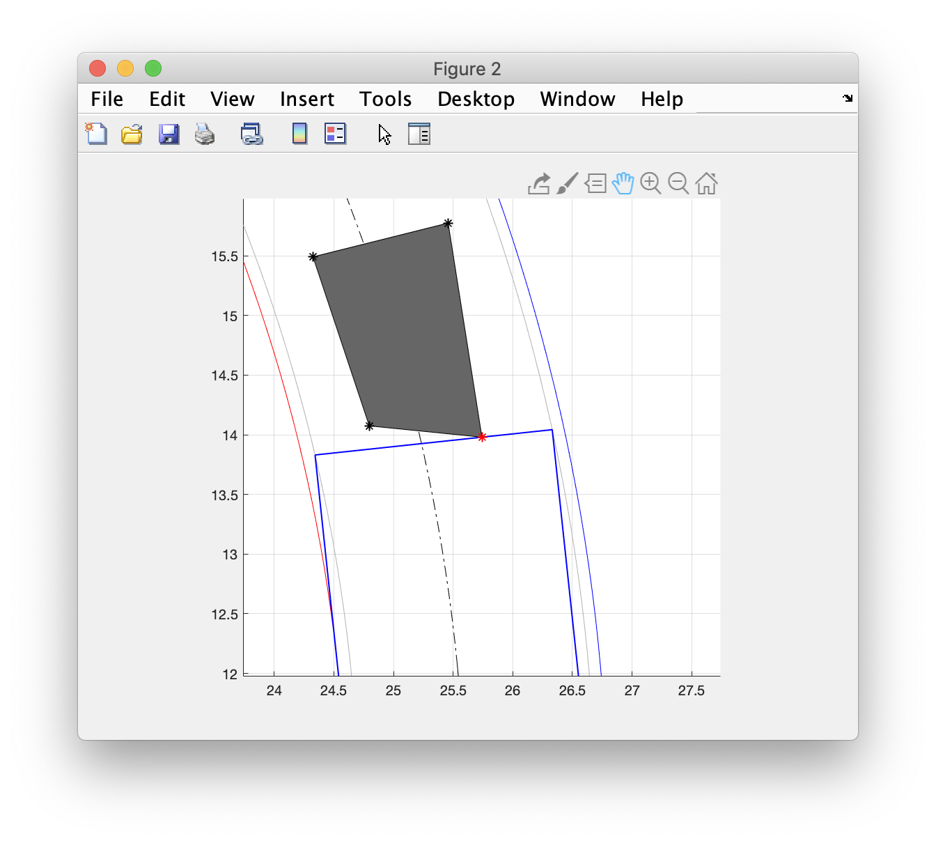
Edge is entirely within track width

Slide 86
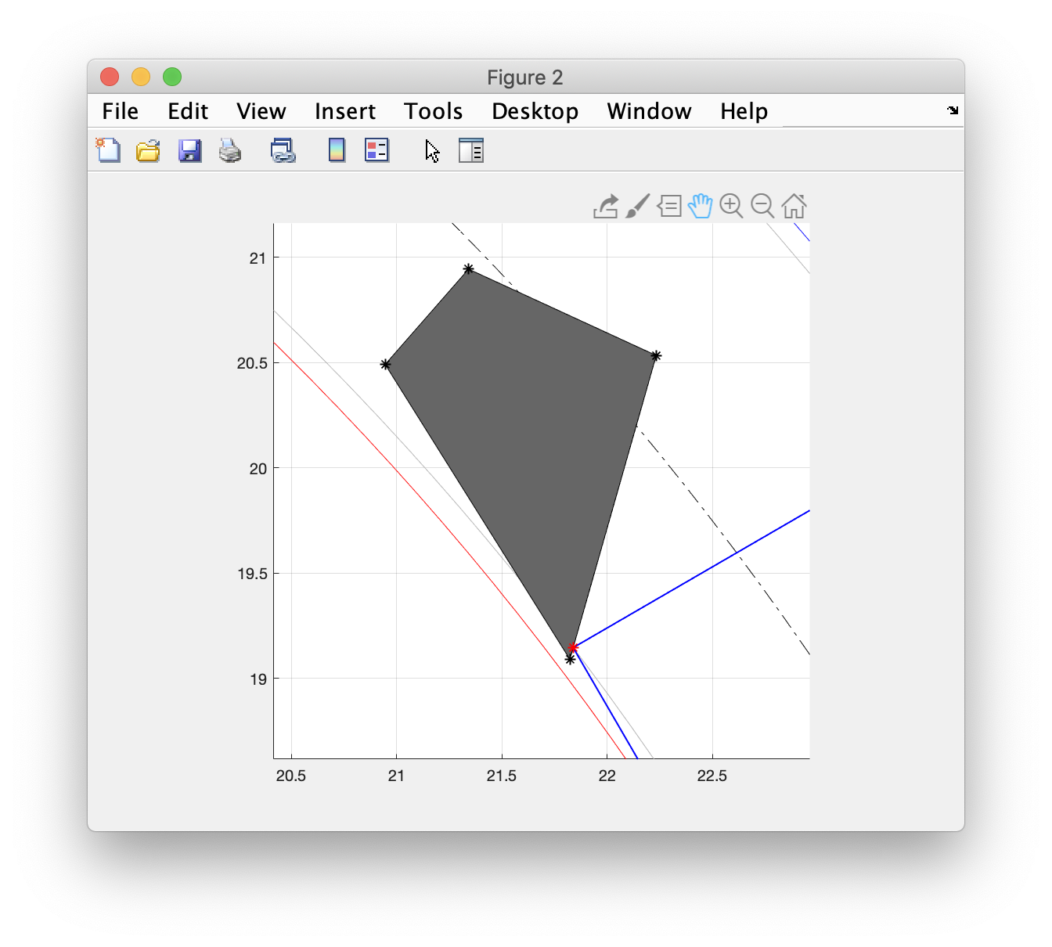
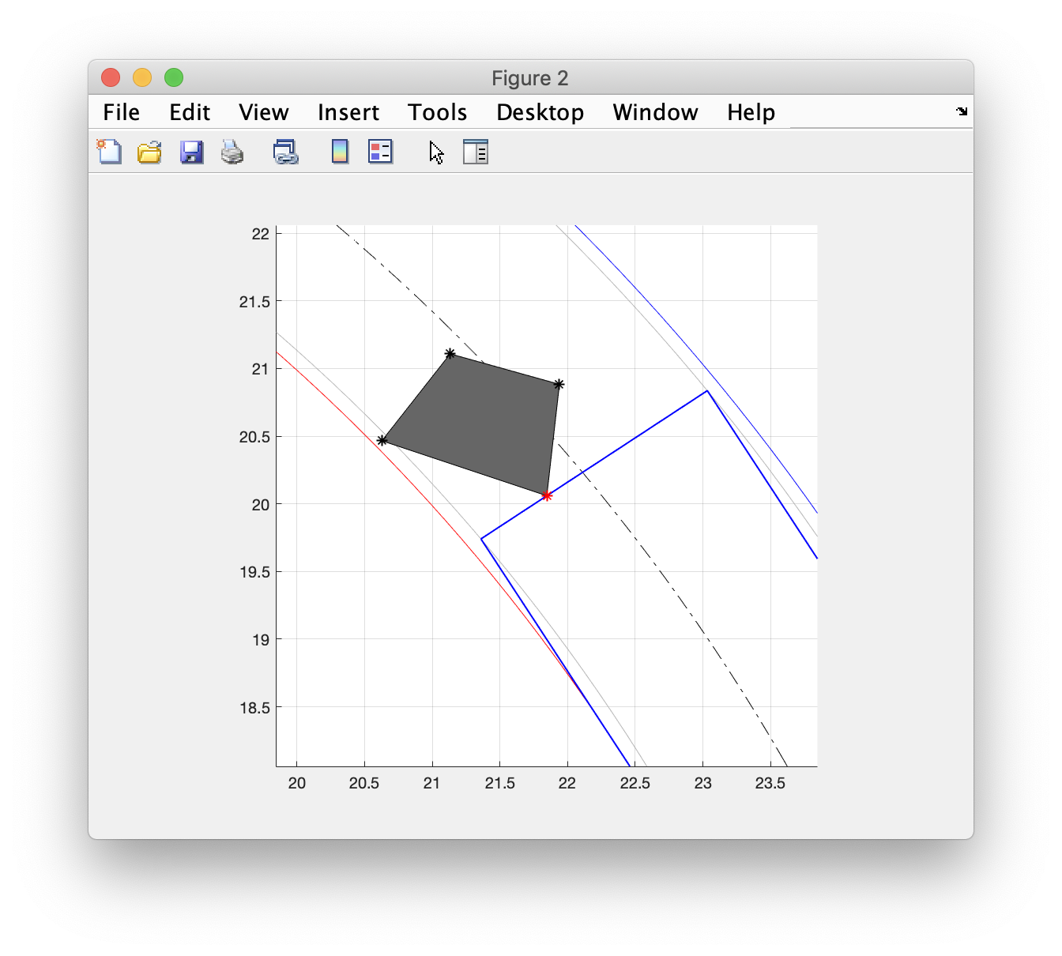
Edge is between minimum radius and track width

Slide 87
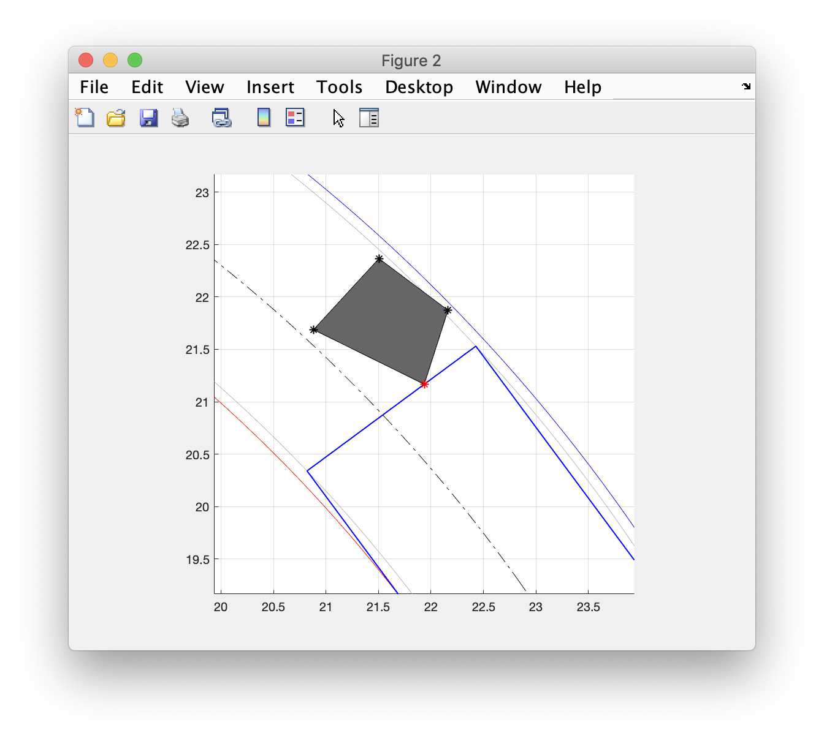
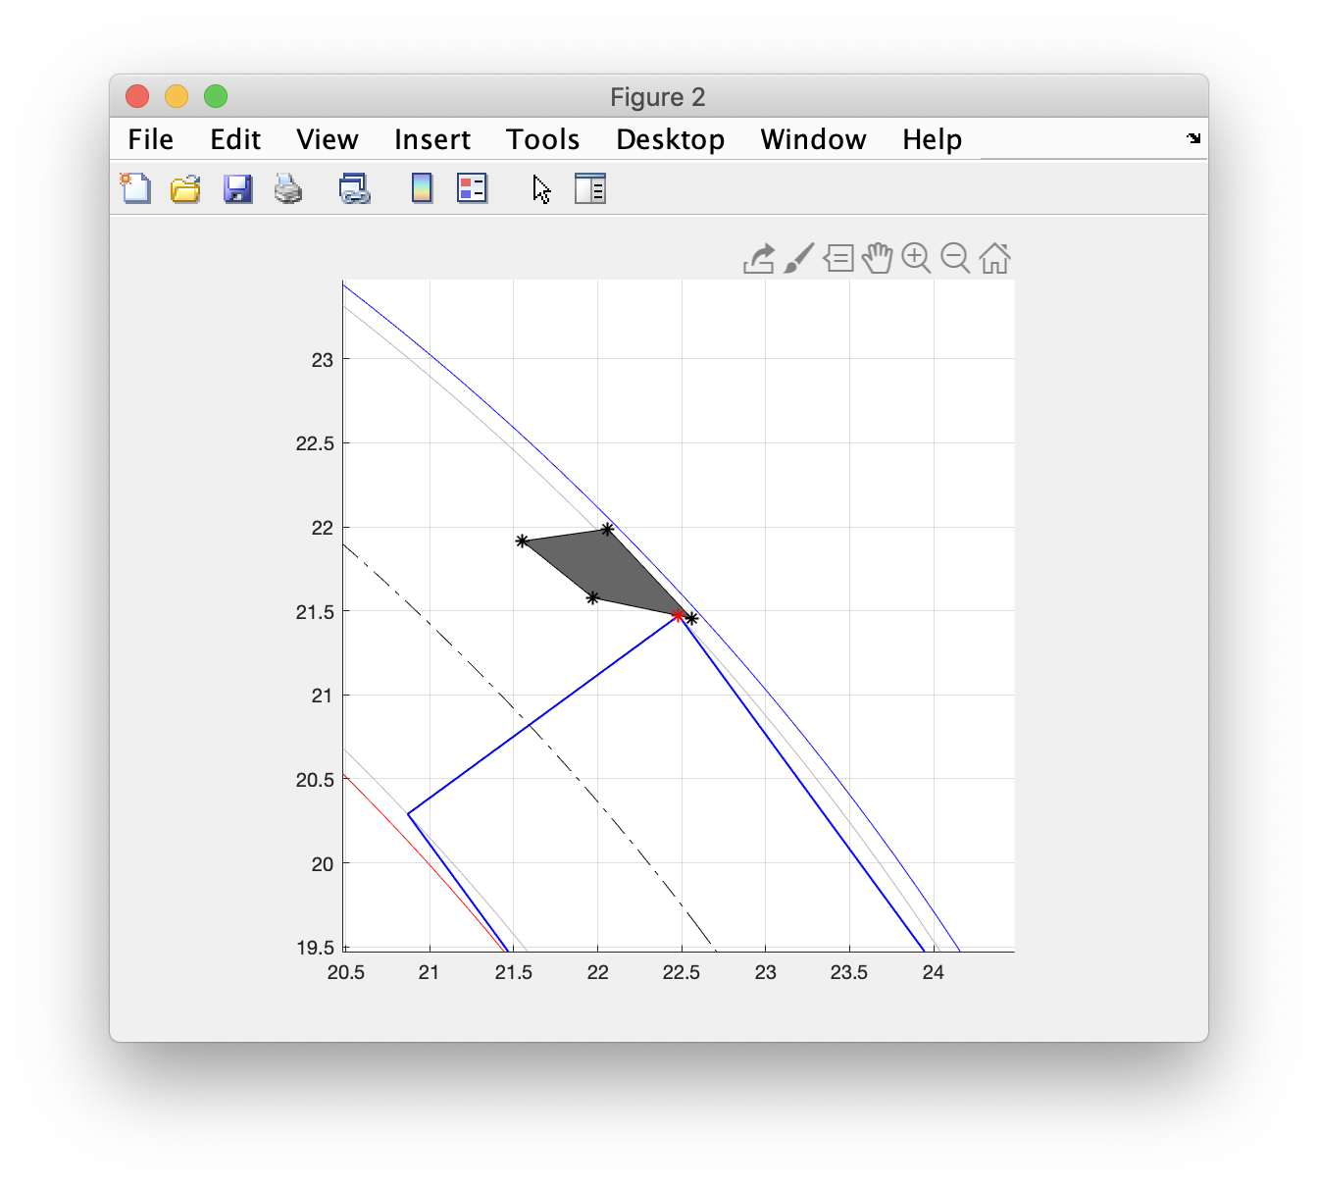
Edge is between maximum radius and track width

Slide 88
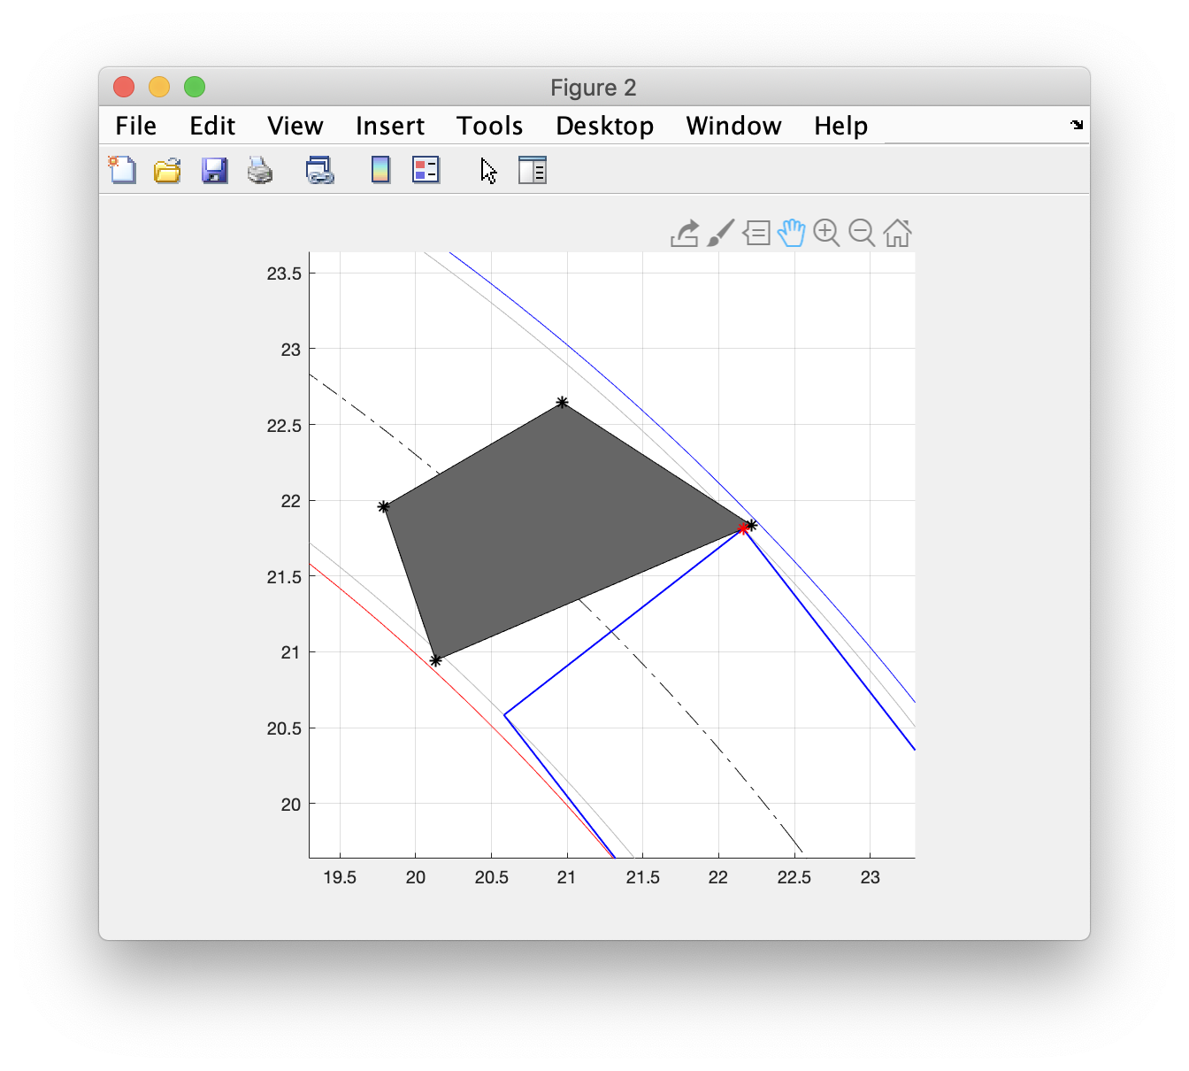
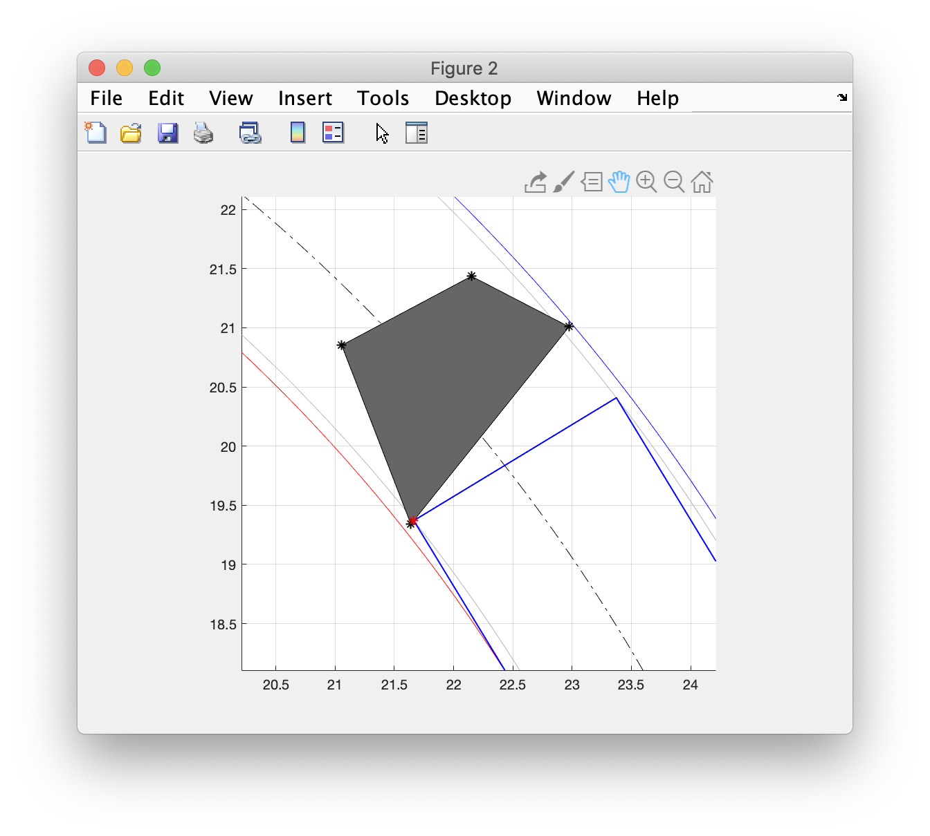
Edge spans the track width but vertices within min and maximum radii

Slide 89
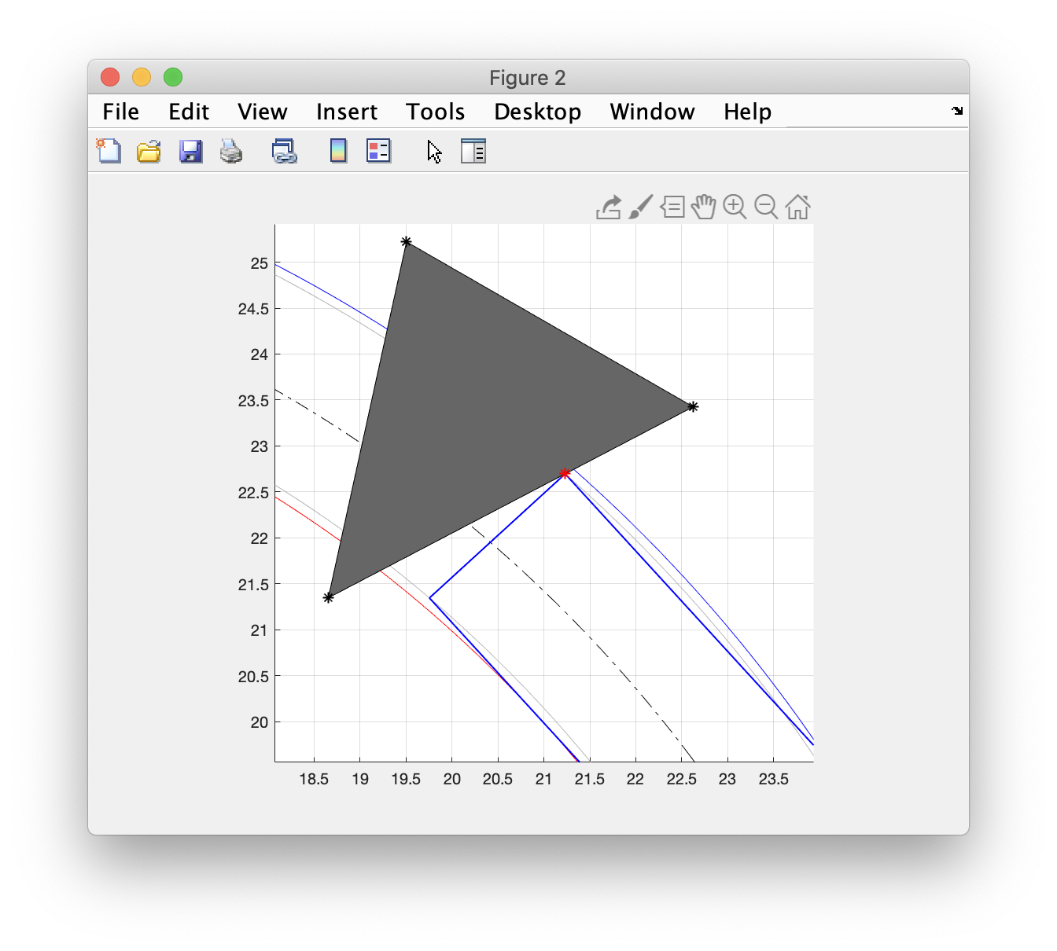
Edge spans the minimum and maximum radii

Slide 90
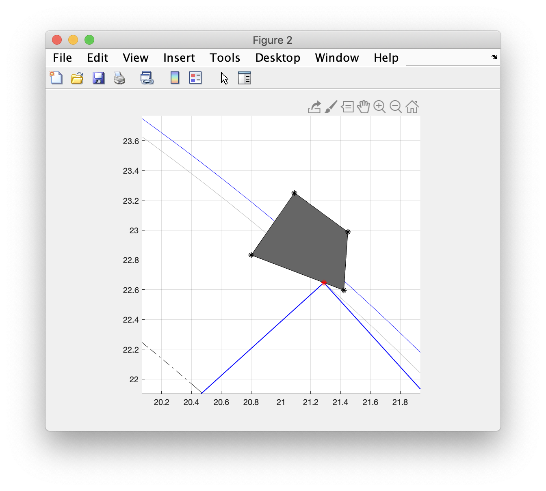


Edge spans max radius with vertex outside of outer front track radius

Slide 91

Edge spans min radius with vertex outside of inner front track radius

Slide 92



Vertices are outside maximum/minimum radii (near miss)

Slide 93
K-Nearest-Neighbor Algorithm

Slide 94
In a construction zone, objects such as cones regularly move around their original positions
Orange circle represents cone from top-down view

Slide 95
In a construction zone, associating XY points would enable us to determine how much cones and other such objects move
Plot showing association of points

Slide 96
X,Y points from two different datasets can be paired as an application of machine leaning (k-nearest neighbor algorithm)
Function: fcn_Points_pairXYdata.m
Script: script_test_fcn_Points_pairXYdata.m
Zoomed in version of the plot on the previous slide

Slide 97
In this problem, we want to associate X,Y data points in one data set (a map, for example) with X,Y data points in another data set
The data sets are not assumed to be sorted or have the same number of points.
A graphical depiction is given for two data sets here:
Data Set A
Data Set B

Slide 98
Association of XY points to XY points
Data Set A
Data Set B
The data sets are likely to have some points that are “mutual matches” where a pair of points in set A and set B are each the closest point to the point in the opposing data set.
The data sets are also likely to have points that do not have a close match once all of the mutual matches have been assigned.

Slide 99
Nearest-neighbor or k-Nearest-Neighbor (kNN) searches are well-researched machine learning algorithms that can help determine mutual matches
MATLAB implementation: [idx, dist] = knnsearch(datasetA, datasetB);
The kNN search will return a vector of indices that indicate the nearest neighbor in datasetA to each point in datasetB.
This can be modified to return a matrix of multiple (k) nearest neighbors for each point in datasetB.
https://www.mathworks.com/help/stats/knnsearch.html
Requires: Statistics and Machine Learning Toolbox

Slide 100
There may be points in set A that are the closest for multiple points in set B, or points that are never identified as a nearest neighbor.
Data Set A
Data Set B
Duplicate
neighbor
Not a
neighbor

Slide 101
How the algorithm works
Data Set A
Data Set B
Apply 1NN search to find the nearest neighbors in both directions
Compare returned indices to determine which points have mutual matches

Slide 102
How the algorithm works (continued)
Data Set A
Data Set B
Check each mutual match the distance is less than a radial limit
Reorganize (or copy) the matched points in Data Set A and Data Set B into a matrix where each row contains the X and Y coordinates of the two points
Optionally, append each of the unmatched points in Data Set A with padding in the last two columns since there aren’t matches in Data Set B
Optionally, append each of the unmatched points in Data Set B with padding in the first two columns since there aren’t matches in Data Set A

Slide 103
For example, here are two repeated but slightly different locations of cones that are correctly associated with each other.
Script: script_test_fcn_Points_addRadialNoise.m
Here, we are checking to see if the cones are within 1 m of each other

Slide 104
Here’s an example where the cone has moved cone has moved outside the user-specified radius., so is not associated with itself over time.
We are still limiting the max association distance to 1 unit, but since the two cones are further apart than this, it is not longer associated.
Script: script_test_fcn_Points_addRadialNoise.m

Slide 105
Associated Data Statistics and Modifications

Slide 106
It is useful to have some statistics for points in datasets that have been associated with each other
RMS Error: the RMS distances associated with the point-to-point match errors
Variance Error: the variance in the point-to-point match error distances
Mean Shift: the [X Y] shift that would cause the centroids of the two data sets to match
A function in the library helps us do this
Function: fcn_Points_calcPairStatistics.m
Script: script_test_fcn_Points_calcPairStatistics.m

Slide 107
Another function allows us to modify the statistics of datasets by adjusting XY points using polar projections. This is illustrated by 1000 biases of the original data.
Datasets can be modified using three methods:
Systematic
Mean Noise
Variance Noise
Function: fcn_Points_adjustPointSetStatistics.m
Script: script_test_fcn_Points_adjustPointSetStatistics.m

Slide 108
A modification on a larger scale would look like this:
Systematic bias of 0.1 on both x and y
Variance noise of 0.1 on x
1-D gaussian noise
Variance noise of 0.1 on x and y
2-D gaussian noise

Slide 109
addRadialNoise is a function that adds random noise in a radial manner
For a point centered at [0,0], here is noise added radially with a radius of 0.5 units. The function was iterated 300 times to show the circle of noise
Function: fcn_Points_addRadialNoise.m
Script: script_test_fcn_Points_addRadialNoise.m

Slide 110
Here’s an example where many cones are measured twice. All are moved, some disappear, and some appear in the 2nd measurement.
1st measurement
2nd measurement
Green circles => measured twice. Red circles if measured in set A but missing in set B, and blue circles if measured in Set B but missing in set A.

Slide 111
References
https://www.freepik.com/free-vector/set-construction-site-objects_27285642.htm
https://www.istockphoto.com/photos/road-construction-barrels
https://www.wired.com/2017/02/self-driving-cars-cant-even-construction-zones/
https://www.randyakin.com/blog/2019/12/29/sideswipe-car-accidents-203205
https://www.pexco.com/traffic/products/barricade-products/
http://www.pragati-trafficsafety.com/Safety-Barricades-and-Cones/Flexible-Traffic-Cone
https://www.istockphoto.com/search/2/image?phrase=road+construction+barrels
https://www.mathworks.com/help/driving/ug/coordinate-systems.html

Slide 112


Slide 113
R_{max}
R_{min}
Case 2 closest point
Case 2:
Object lies inside R_{min}

Slide 114
R_{max}
R_{min}
Case 1:
Object lies outside R_{max}
Case 1 closest point

